Slide 1
Pennsylvania Water Environment Federation
PennTEC Annual Technical Conference
June 4, 2013
Altoona Westerly Wastewater Treatment Facility
BNR Conversion with Wet Weather Accommodation
Presented by:
Jim Balliet, Secretary/Facilities Planning Director
GWIN, DOBSON & FOREMAN, INC.
Consulting Engineers

Slide 2
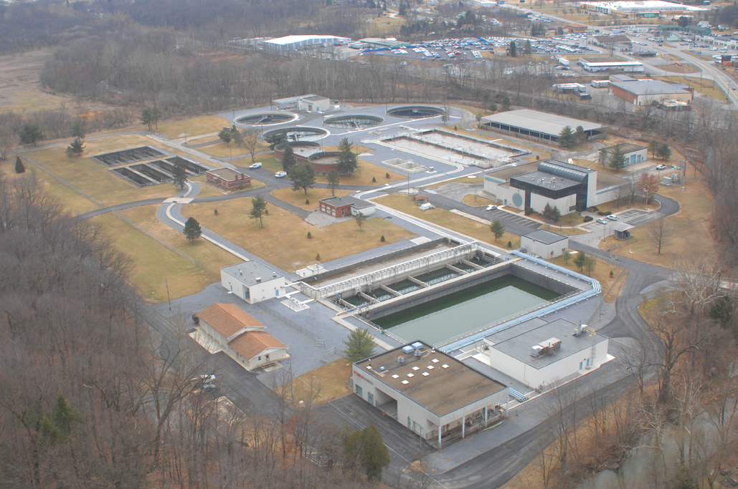

Slide 3
Westerly Treatment Facility
Originally constructed in 1952
Upstream 125 year old CSO System; “first flush” storage and pumping facility
Upgraded in 1990
  Coarse screening and aerated grit removal
  Complete mix activated sludge, single stage nitrification
  Final clarification and UV disinfection
  Equalization storage
Avg. Daily Flow – 10.8 mgd, Peak Flow – 60 mgd
Altoona Water Authority – System Owner/Operator

Slide 4
The Chesapeake Bay Strategy
PA Dept. of Environmental Protection issued new NPDES permits to Altoona with mass annual nutrient load limits
Average effluent Nitrogen of 14.4 mg/l exceeds future cap load by 80,000 pounds, reduce N discharge by 45%
Average effluent Phosphorus of 3.0 mg/l exceeds future cap load by 15,000 pounds, reduce P discharge by 55%
Nutrient Cap Load Target Concentrations:
  Effluent Nitrogen – 5.0 mg/l
  Effluent Phosphorus – 0.67 mg/l

Slide 5
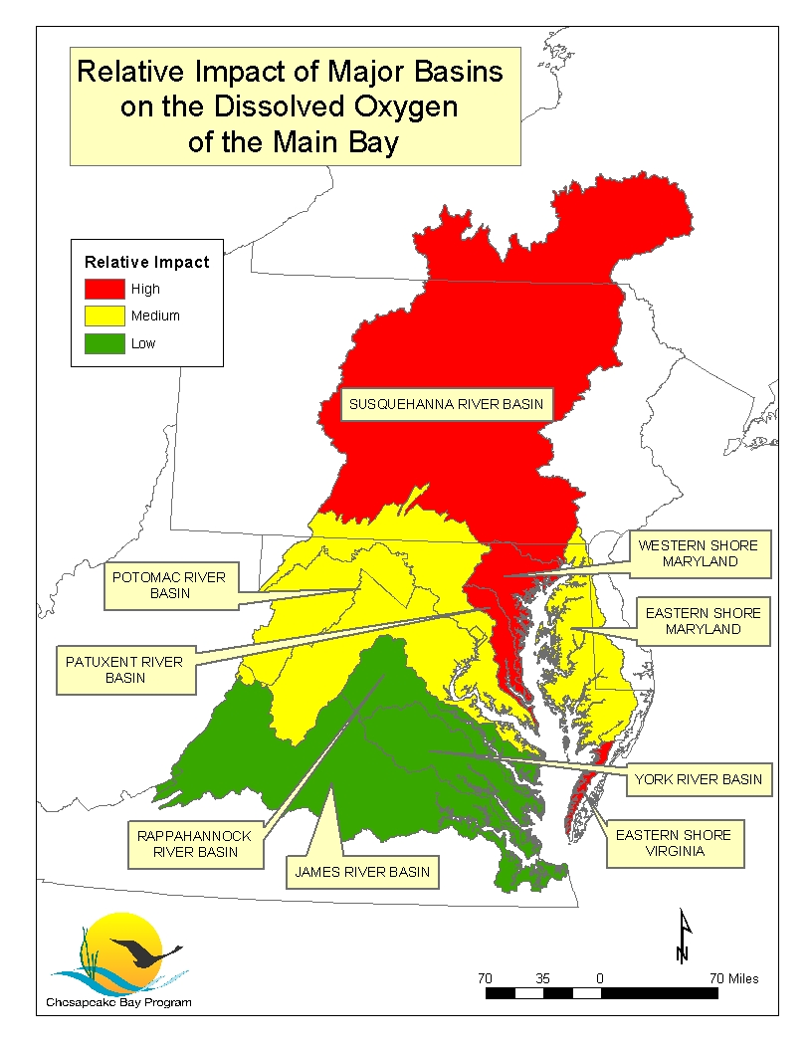
Altoona
Notes:
Distributing the Load
-what areas had most impact on Bay was a primary factor
-generally northern tribs have highest impact

Slide 6
Project Goals
Reduce effluent nutrients levels to ensure regulatory compliance
Treat wet weather CSO flows while preventing washout of process nutrient biomass
Use sustainable design by maximizing use of existing facilities; reduce chemical consumption/waste solids
Reduce energy consumption using gravity flow, efficient NRT process
Reduce operating costs by using energy-efficient equipment and process monitoring & control system
Generate nutrient credits for sale on PA credit market

Slide 7
Evaluation of Alternatives
Conducted extensive influent testing to characterize waste over full range of flows
Evaluated existing treatment processes and conducted preliminary screening of various Nutrient Removal Technologies (NRT)
BioWin process modeling of selected NRT processes with site-specific kinetic rates verified by High F/M testing
Evaluate wet weather CSO treatment options
Process evaluation by GDF and Bassett Engineering (process modeling and NRT consultant)

Slide 8
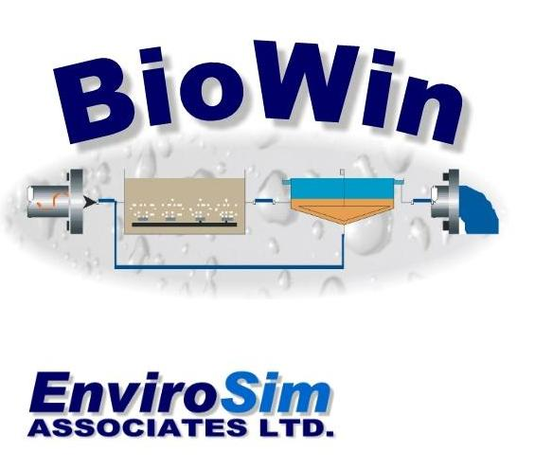
Simulates biological processes of wastewater treatment plants
Developed By

Slide 9
BioWin Model for NRT Process

Slide 10
Selected Process
  Replace existing screens with fine screens.
  Replace aerated grit system with vortex grit separators
  Convert south EQ tank to two plug flow reactors.
  Convert existing aeration basins to two plug flow reactors.
  Construct fourth secondary clarifier.
  Provide chemical feed systems.
  Upgrade SCADA/instrumentation systems.

Slide 11
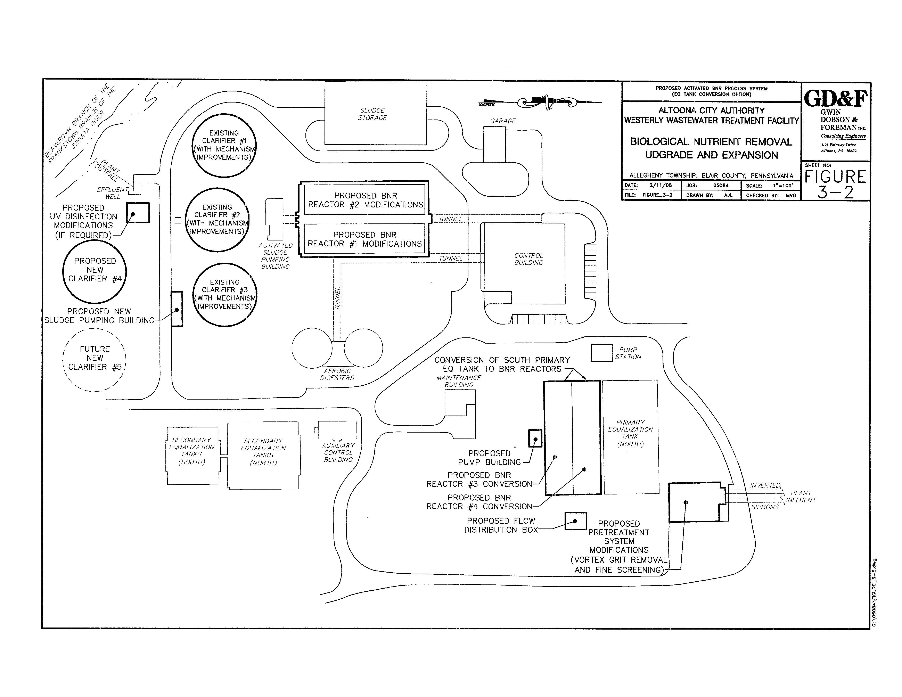
Selected Process

Slide 12
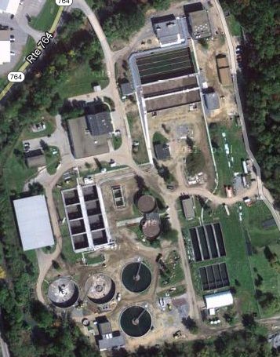
1) Headworks building, 2) Primary Equalization Tanks, 3) Secondary Equalization Tanks 4) BNR Reactors 1 & 2, 5) BNR Reactors 3 & 4, 6) Final Clarifiers, 7) UV Units, 8) Aerobic Digesters, 9) Digested Solids EQ/Feed Tank, 10) Control Building and Sludge Handling
3
5
1
2
8
6
9
7
10
4

Slide 13
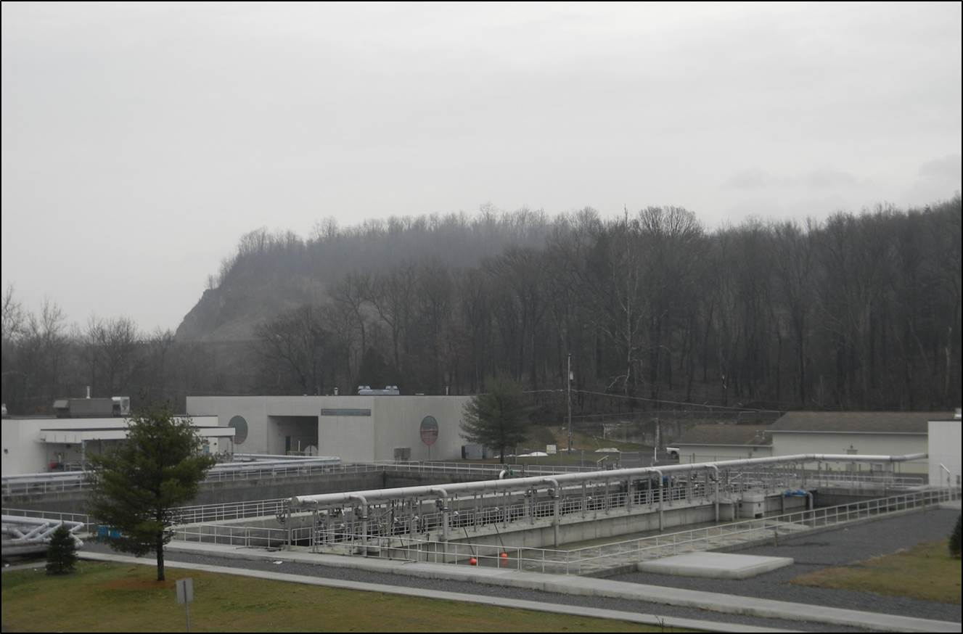
Conversion of South Equalization Tank to NRT Reactors

Slide 14
Selected Process
  Provide nutrient removal using four plug NRT reactors.
  Operational flexibility to operate various nutrient removal processes including Bardenpho, MLE, VIP, A20 and Hybrid
  Step feed high, diluted wet weather CSO flow to last oxic and swing zones to provide secondary (contact stabilization) treatment

Slide 16
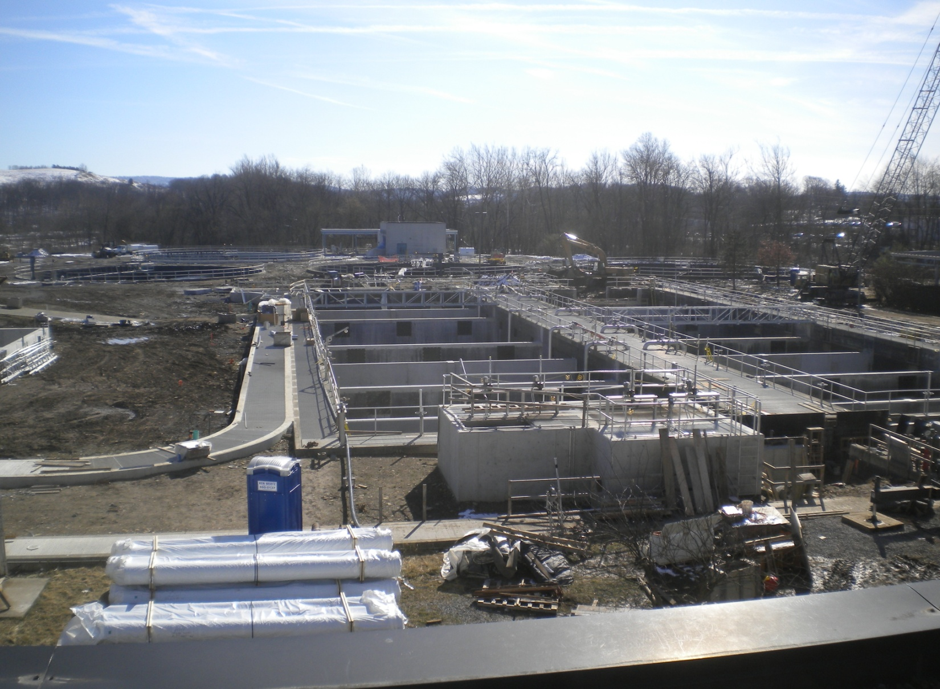
Construction of Aeration Tanks Conversion, Distribution Box and Adjacent Step-Feed Channel

Slide 17
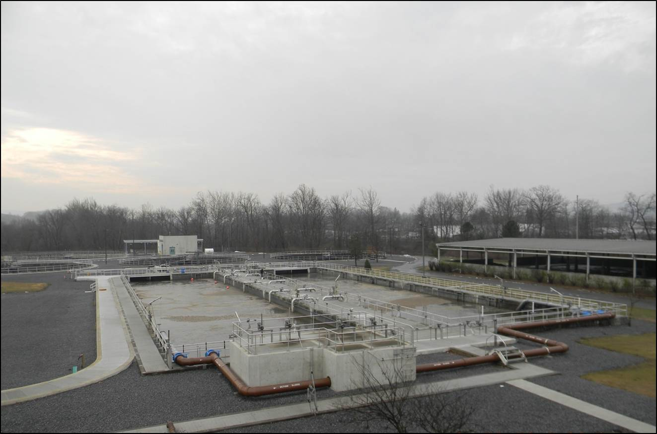
Existing Aeration Tanks Converted to NRT Reactors and Adjacent Step-Feed Channel to Last Oxic Zone

Slide 18
Hybrid BNR Feature
  Process combines the mixed liquor recycle feature from the VIP process with the Bardenpho process
  Mixed liquor from the final anoxic zone is recycled to the first anaerobic zone
  Lowers the oxidation/reduction potential (ORP) in the anaerobic zone
  Increases phosphorus release and enhances biological phosphorus removal
  Consistently meets P limits without chemical addition

Slide 19
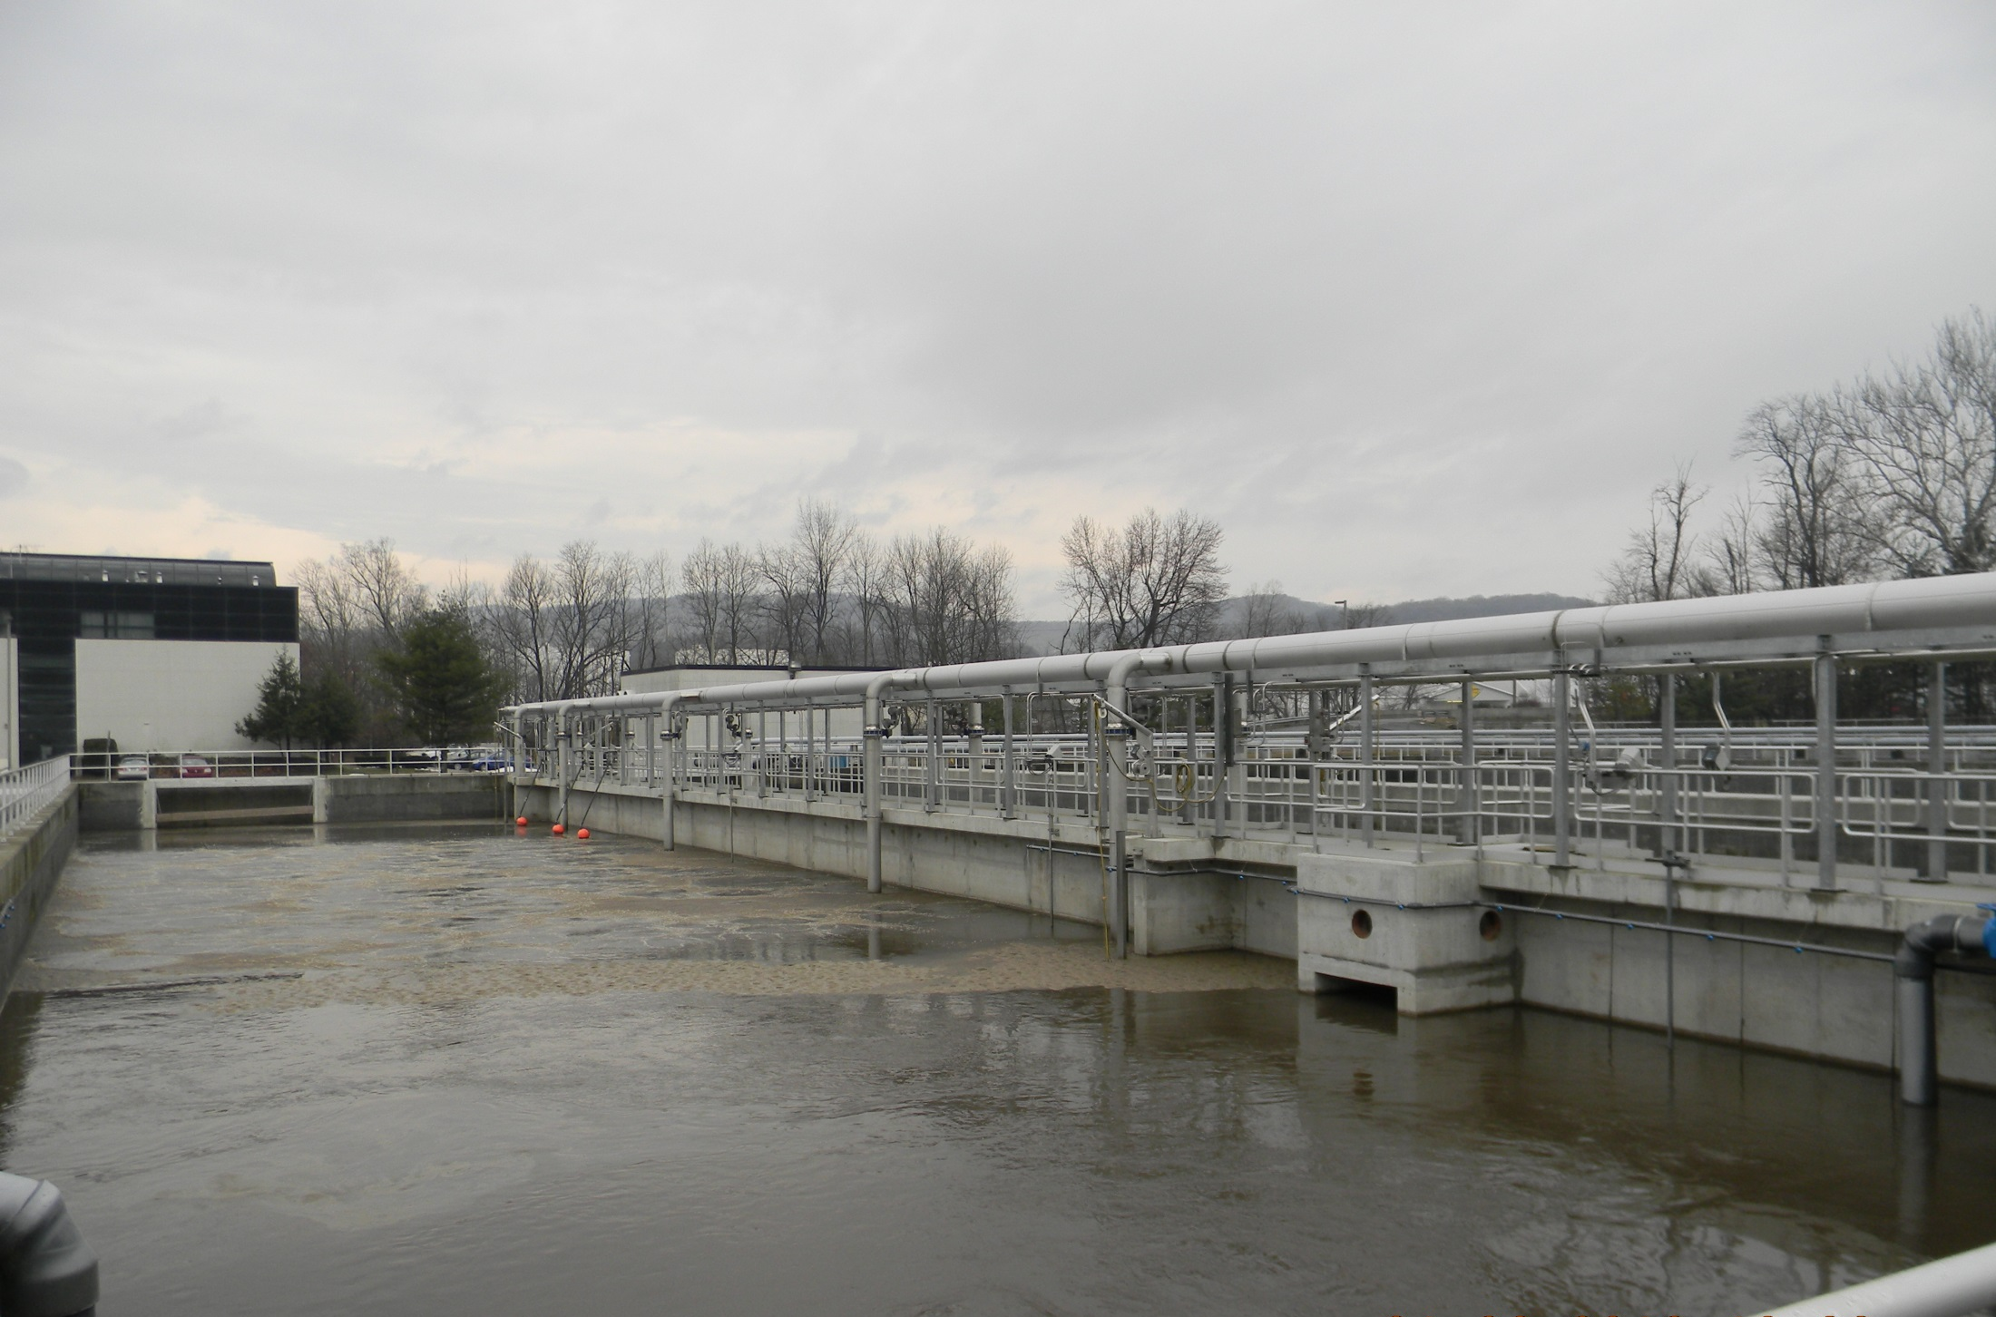
NRT Reactor

Slide 20
Step Feed
  Diverts high wet weather CSO flow to last oxic zone
  Provides biological treatment of all CSO flows via contact stabilization (1-2 hour detention)
  Preserves treatment process sequence (anaerobic, anoxic and aerobic)
  Preserves nitrifiers and maintains N removal during and after high flow events
  Prevents elevated DO concentrations in process.
  Preserves solids washout in clarifiers

Slide 21
Sustainable Design
  Converted existing aeration tank into two plug flow NRT reactors
  Converted existing equalization basin into two plug flow NRT reactors
  Existing tanks were retrofitted with baffle walls to create anaerobic, anoxic and aerobic zones
  Constructed slightly submerged walls with underflow ports
  Located recycle pumps in existing pipe gallery
  Reused air distribution piping, existing flow distribution channels, RAS piping and effluent channels

Slide 22
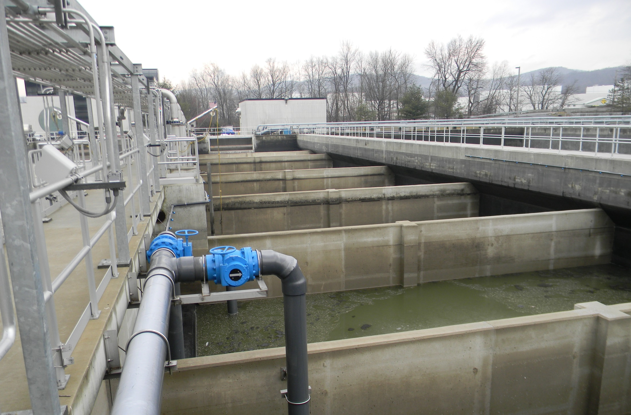
Retrofitting of Existing Equalization Tank to NRT Reactor

Slide 23
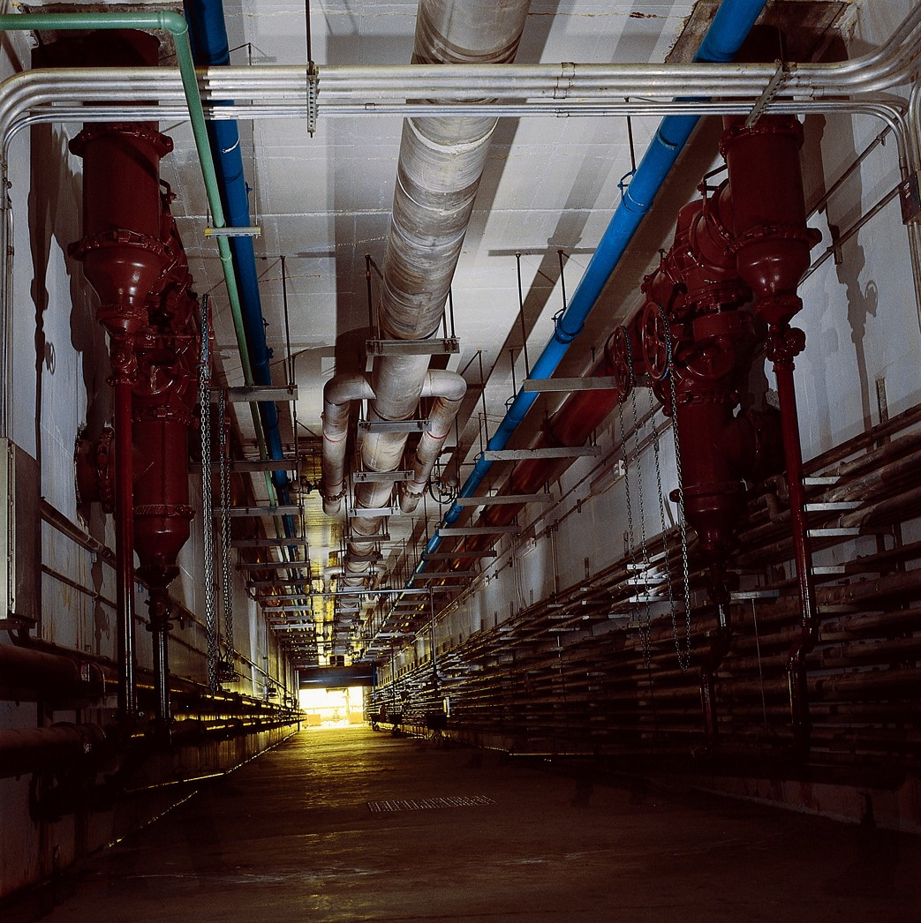
Pipe Gallery Tunnel with Internal Recycle & Air Piping

Slide 24
Operational Flexibility
  Facility can operate in a variety of plug flow NRT removal modes (MLE, Stage 4/5 Bardenpho)
  Current operation uses Virginia Initiative Plant (VIP) process for step feeding wet weather flow
  Second anoxic zone is a switch zone (mixer and diffusers) and can operate as an oxic zone during step feed
  VIP process produces lower effluent N during cold weather without the second anoxic zone
  Internal RAS/MLSS/Nutrient recycle streams can draw and pump to multiple zones
  Wet weather CSO flow treated in contact stabilization mode in switch zone/last oxic zone

Slide 25
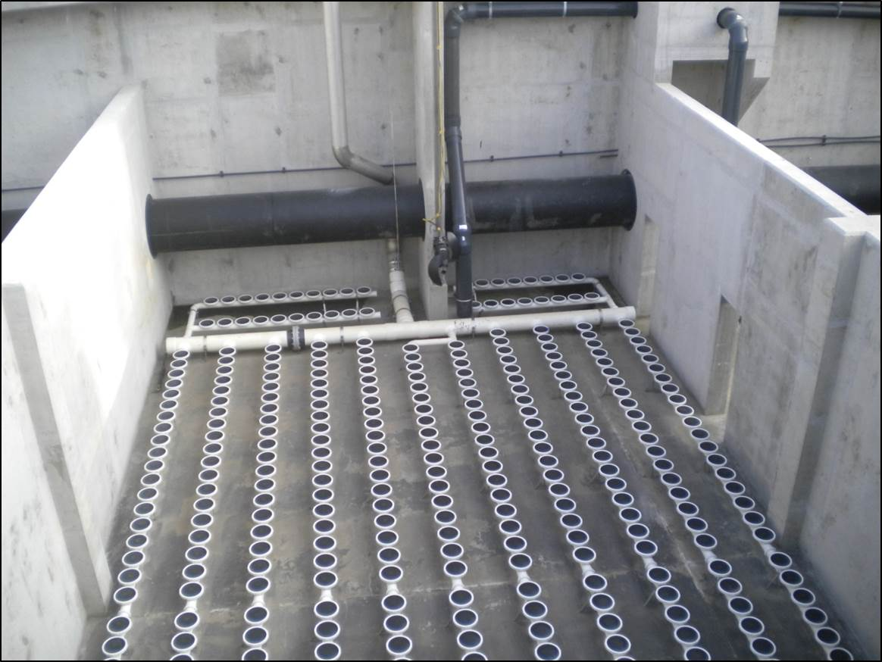
Switch Zone – Membrane Diffusers (oxic) & Submersible Mixers (anoxic)

Slide 26
BNR Initial Process Parameters
September 2011 – February 2012
 | SRT | WAS | FM Ratio | MLSS | RAS | Total RAS | NR | MLR
 | (Days) | (MGD) | (per day) | (mg/L) | (mg/L) | (MGD) | (MGD) | (MGD)
Minimum | 2.25 | 0.07 | 0.04 | 1,835 | 3,700 | 2.60 | 1.60 | 0.90
Average | 6.20 | 0.18 | 0.11 | 3,420 | 8,680 | 6.20 | 3.75 | 2.00
Maximum | 14.50 | 0.34 | 0.33 | 4,880 | 11,950 | 8.30 | 4.70 | 2.50

Slide 27
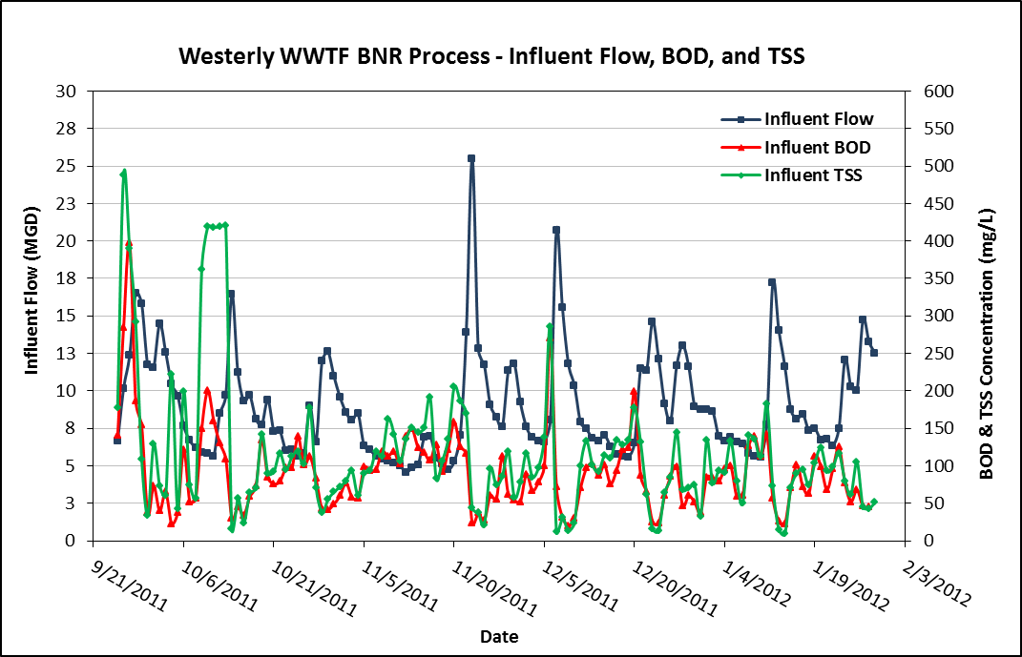
VIP Process Operation During Wet Weather Flow

Slide 28
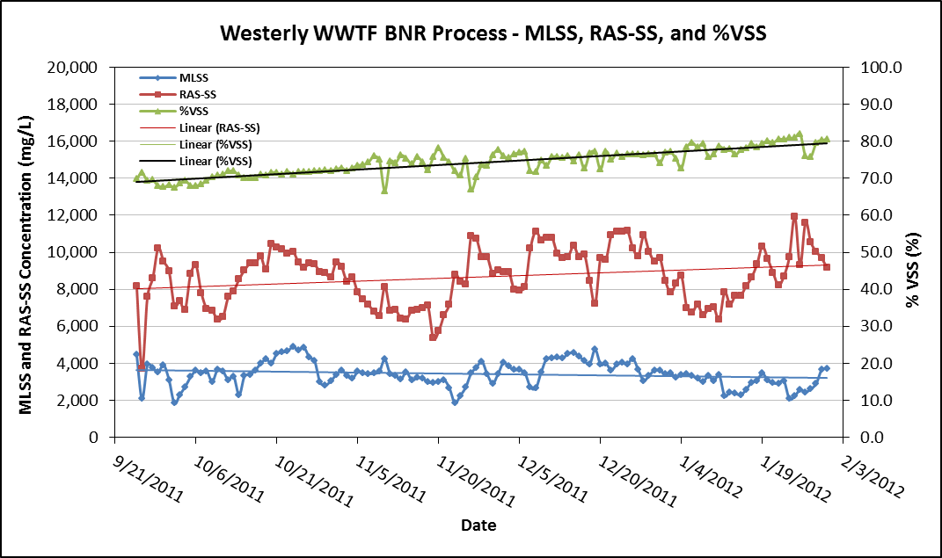
VIP Process Operation During Wet Weather Flow

Slide 29
Final Clarification
  Project included the addition of a fourth clarifier and upgrades to existing three clarifiers
  Surface overflow rate adequate for 60 mgd peak
  Employed rapid sludge removal via spiral blade sludge collectors
  Full radius skimmers
  Current density baffles (Stamford-type)
  Sludge blanket density meters

Slide 30
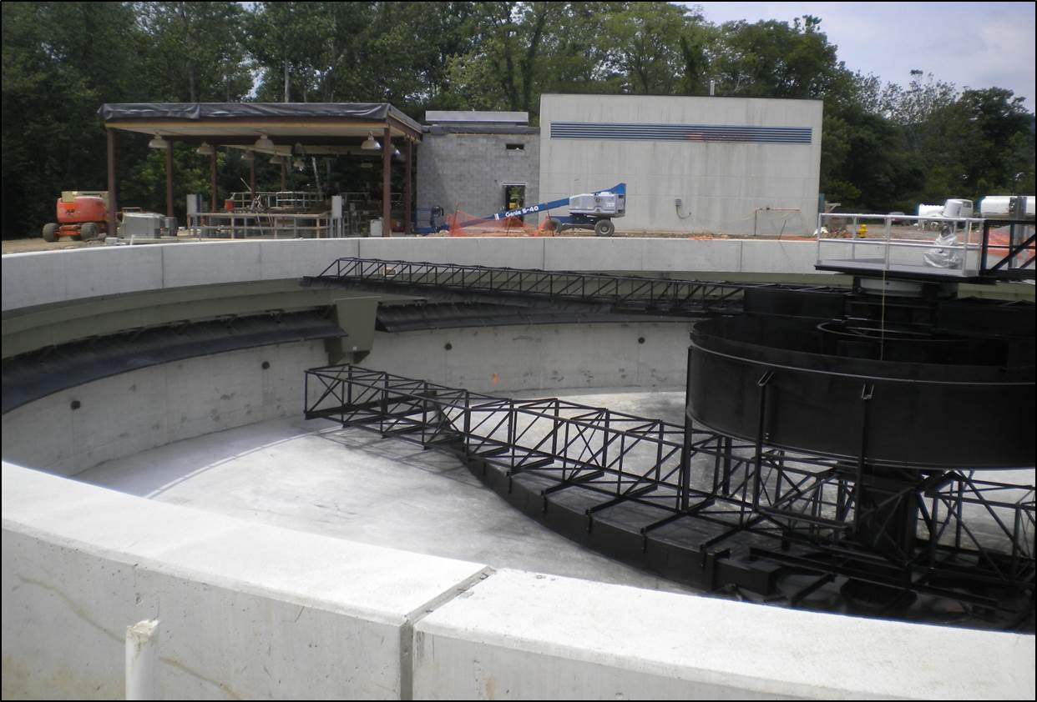
Final Clarifiers with Stamford Baffles

Slide 31
SCADA Process Control Features
  Step-feed process flow control
  Mixed liquor and nitrate recycle return rate
  RAS and WAS return rates
  DO control of air supply valves and blower speeds
  NO₄ control of nitrate recycle pumps and methanol
  RP control of mixed liquor recycle
  pH control of caustic soda feed
  NH₄ and PO₄ instruments provide process alarms

Slide 32
Other Facility Improvements
  Fine Screening
  Non-Aerated Vortex Grit Separation
  Final Clarifier Additions and Upgrades
  Ultraviolet Disinfection System
  Aerobic Digester System Upgrades
  Effluent Screw Lift Pumps

Slide 33
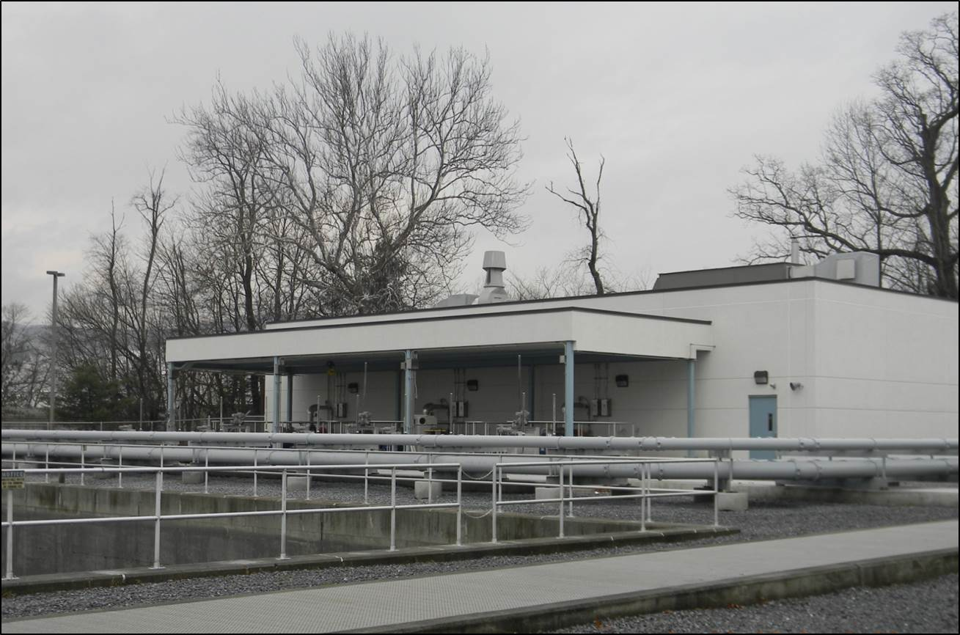
New Headworks Building

Slide 34
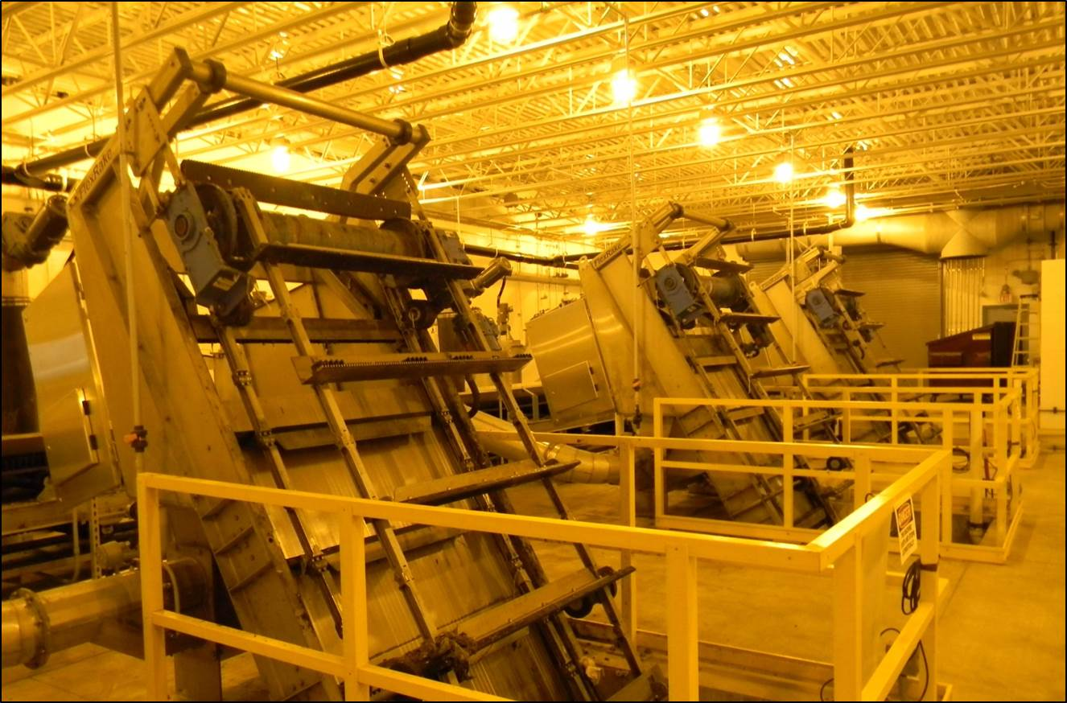
Headworks Fine Screening

Slide 35
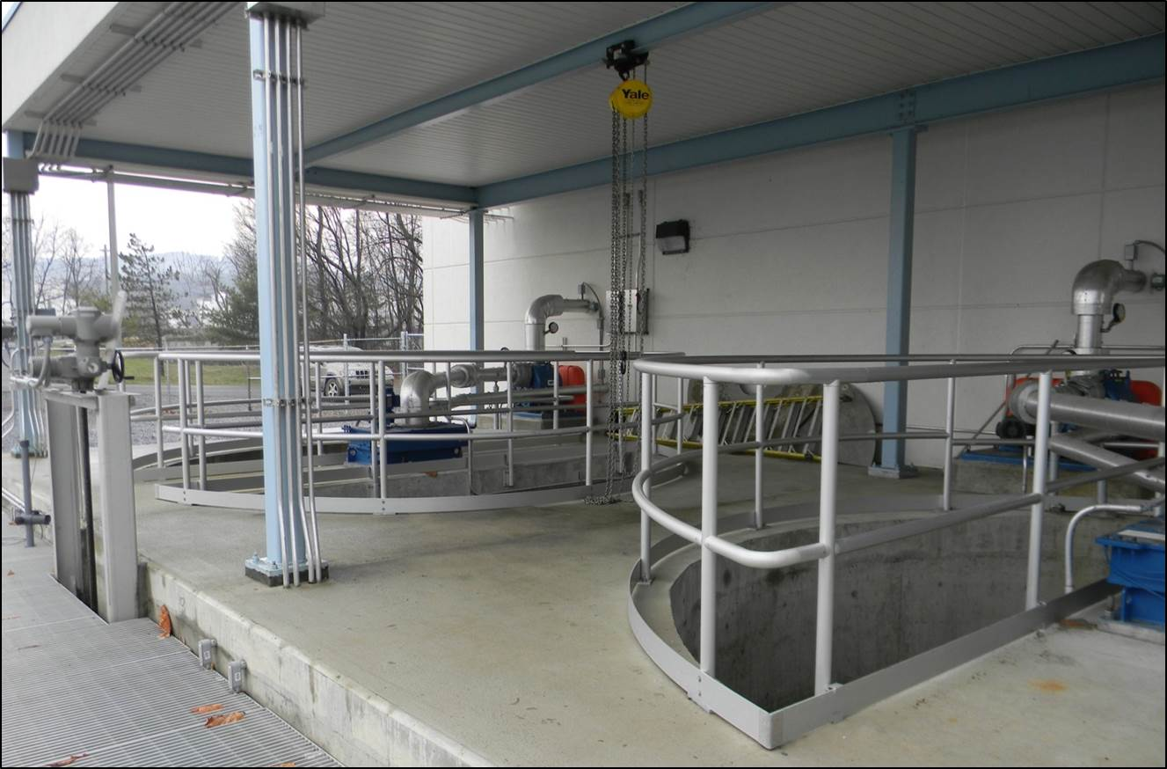
Vortex Grit Separation System (preserve influent carbon)

Slide 36
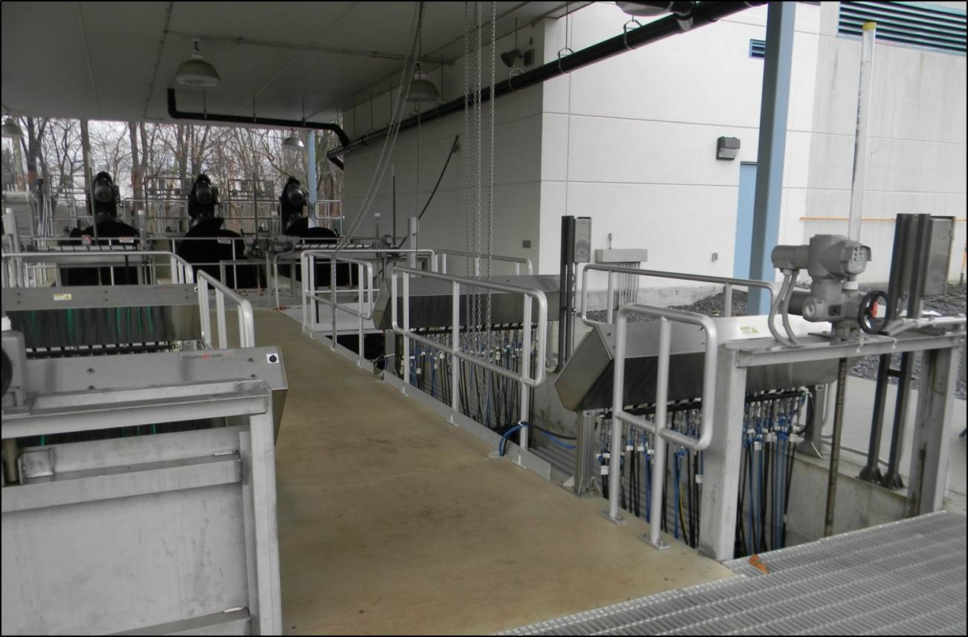
Ultraviolet Disinfection System

Slide 37
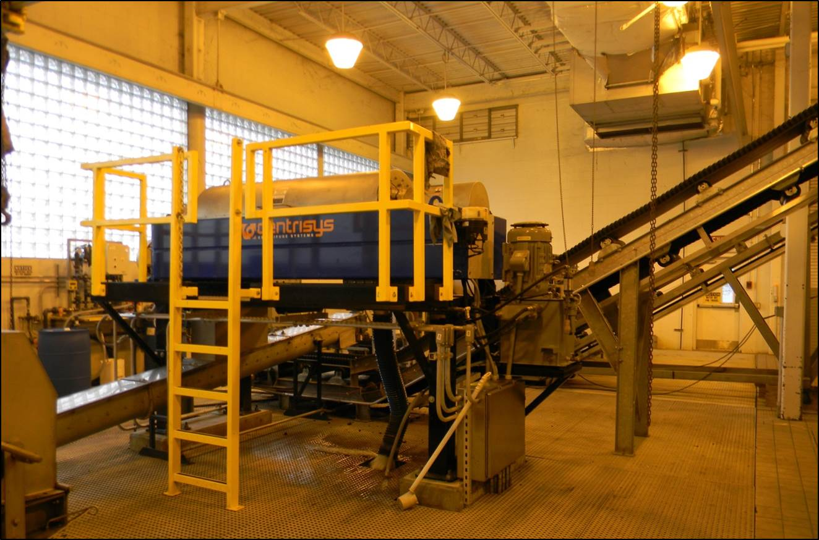
Centrifuge Sludge Dewatering System

Slide 38
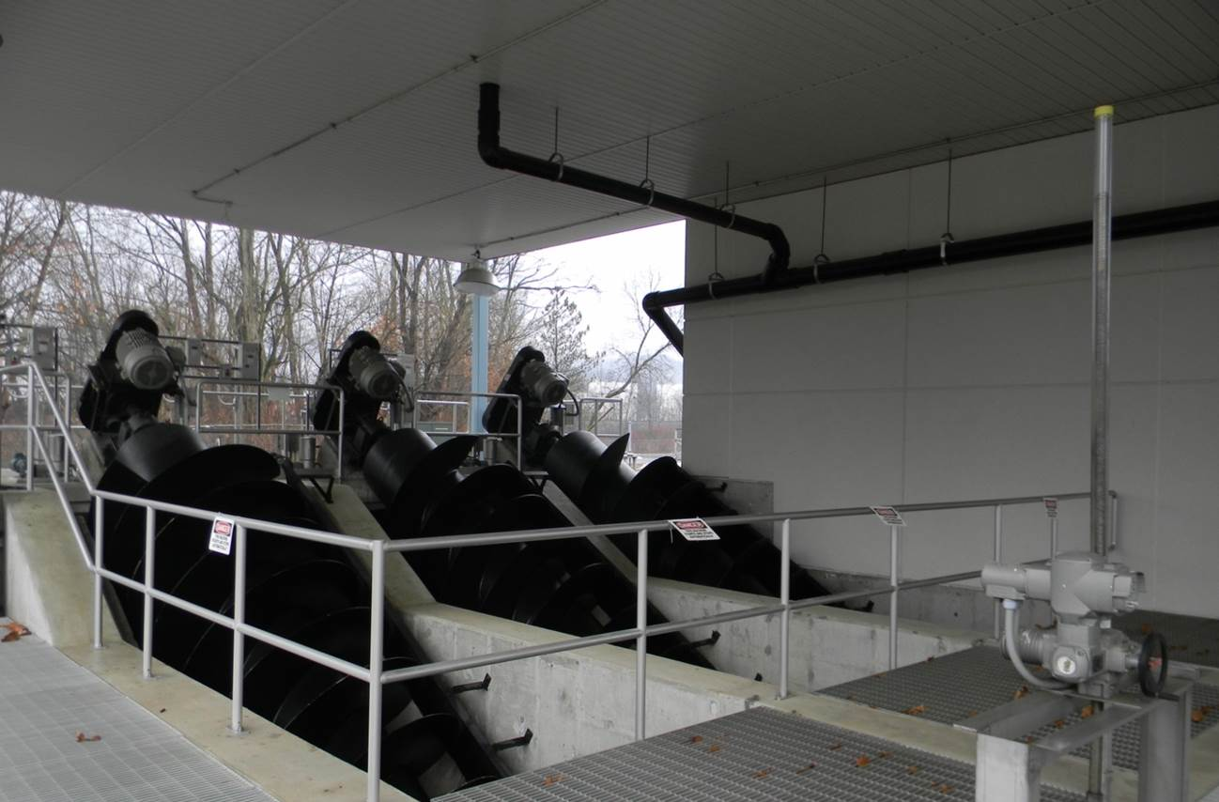
60” Diameter Screw Lift Flood Pumps

Slide 39
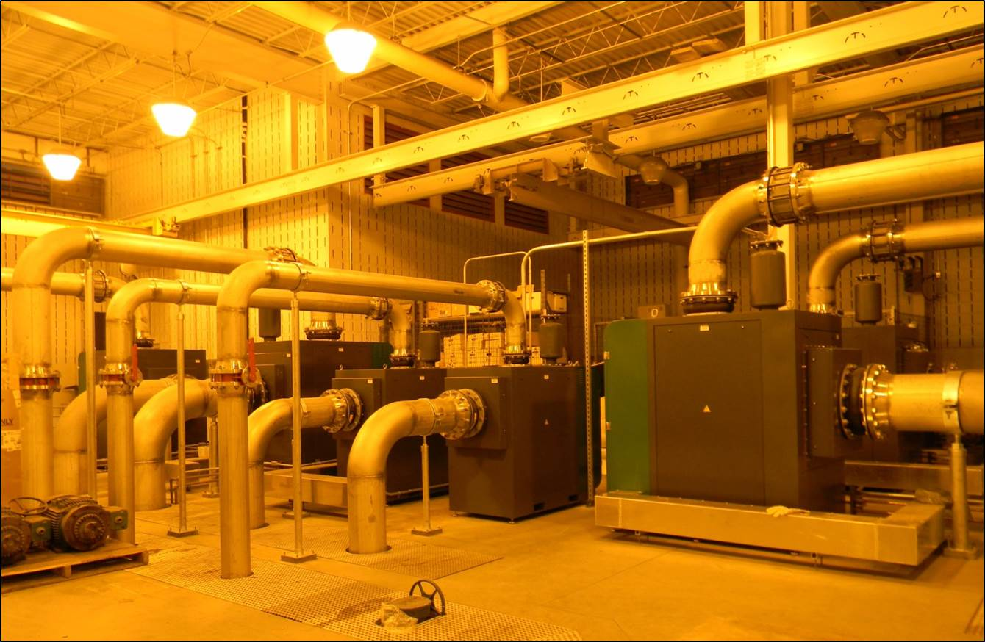
Energy Efficient Turbo Blowers (high turndown capability)

Slide 40
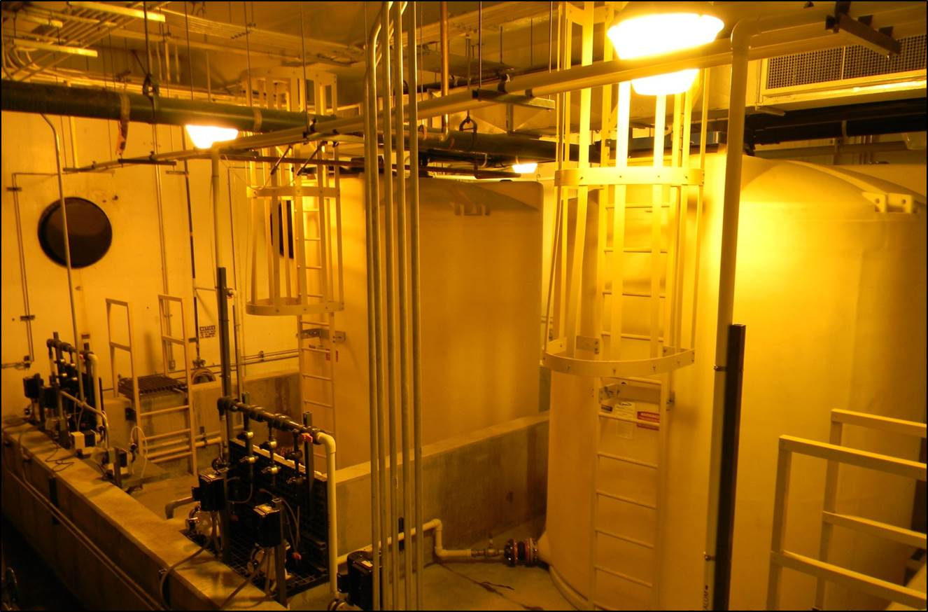
Chemical Feed and Storage Facilities

Slide 41
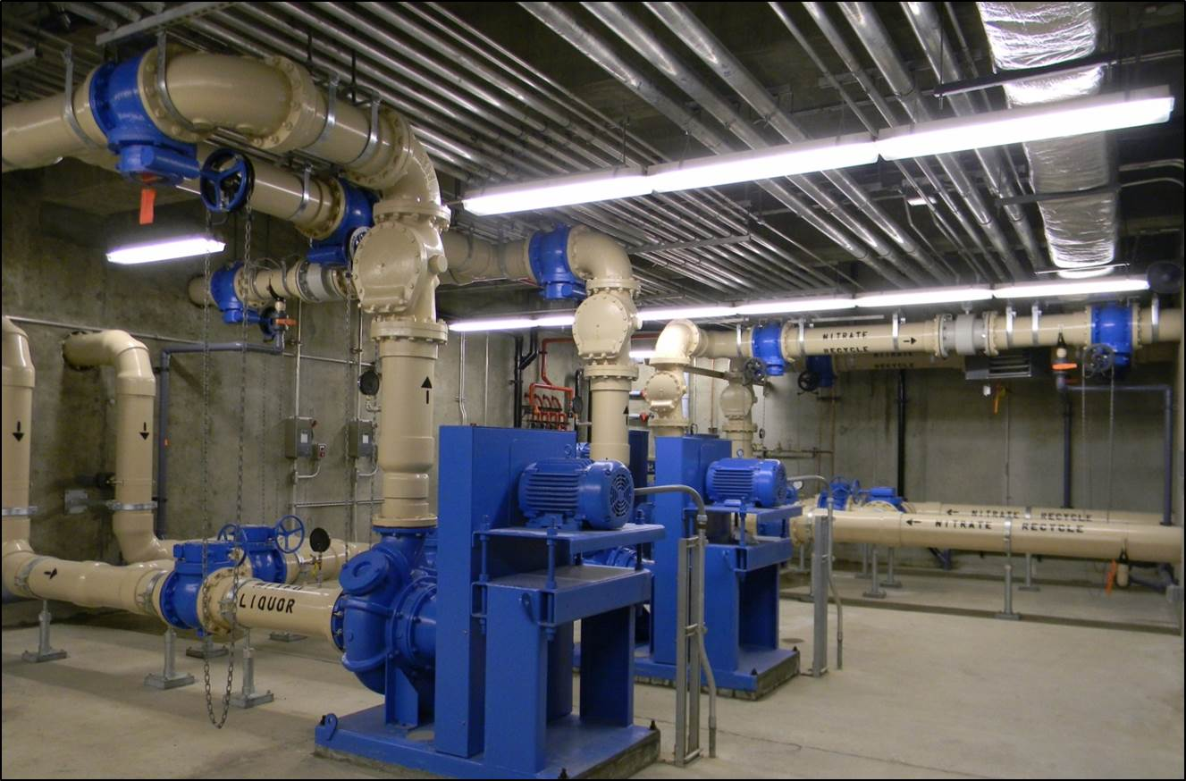
Internal Recycle Pumps – Mixed Liquor & Nitrate

Slide 42
BNR Process Results
  Process reduced effluent nitrogen concentration to near 3.0 mg/l with NO CARBON ADDITION
  Reduced annual N loading from 240,000 pounds to 70,000 pounds
  Biologically reduced annual P loading from 32,000 to 6,700 pounds with NO CHEMICAL ADDITION
  Generated $217,000 in nutrient credit revenue
  Processed 100% OF WET WEATHER FLOW WITHIN PERMIT LIMITS WITHOUT BNR PROCESS UPSET
  Annual plant operating costs REDUCED BY $110,000

Slide 43


Slide 46
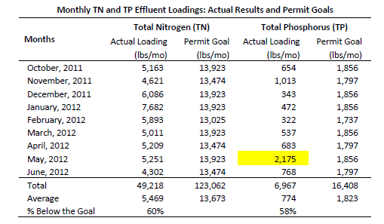

Slide 50
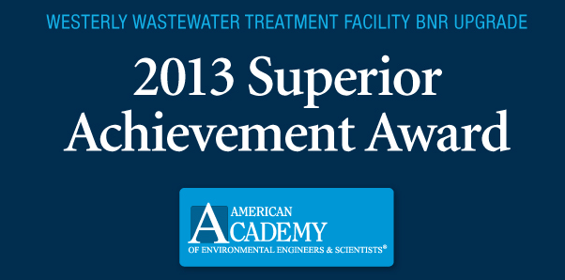

Slide 51
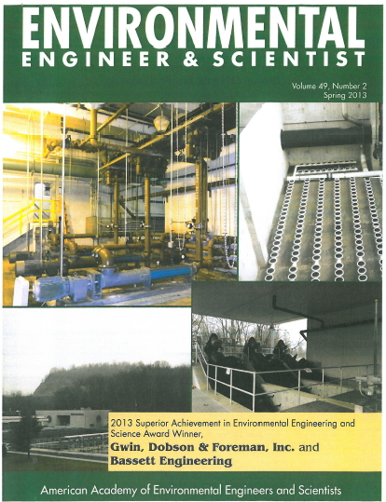

Slide 52
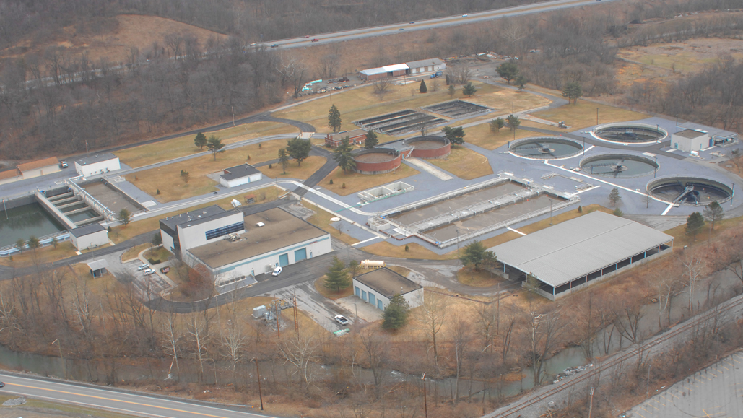
Questions/Discussion

